Slide 1
Topic 8: Introducing Evaluation (Part 1)
SECV2113 Human-Computer Interaction
Faculty of Computing
Universiti Teknologi Malaysia

Slide 2
OVERVIEW
01
TYPES OF EVALUATION
02
EVALUATION CASE STUDIES
03
OTHER ISSUES TO CONSIDER
04

Slide 3
OVERVIEW

Slide 4
Why, What, Where, and When to evaluate
Iterative design and evaluation is a continuous process:
Why: To check that all aspects of the user experience are taken into account in design
What: A conceptual model, early and subsequent prototypes of a new system, more complete prototypes, and to compare a design with competitors’ products
Where: In natural, in-the-wild, in living lab and lab settings
When: Throughout design; finished products can be evaluated to collect information to inform new products and for comparisons with other products

Slide 5
TYPES OF
EVALUATION

Slide 6
Evaluation Types
Controlled settings that directly involve users (for example, usability and research labs)
Natural settings involving users (for instance, online communities and products that are used in public places)
Often there is little or no control over what users do, especially in in-the-wild settings
Any setting that doesn’t directly involve users (for example, consultants and researchers critique the prototypes, and may predict and model how successful they will be when used by users
Remote evaluation can be done with studies in all three categories above.
Remote evaluation was practiced since the 1990s but it became important recently for coping with the impact of the Covid-19 pandemic
Different methods my also be used together to provide different perspectives. For example, testing in a lab maybe used to compare different parts of a design, such as two different menu structures. Then the design may be tested in a natural setting to see whether people like using it in their homes or in other natural settings

Slide 7
Living Labs
People’s use of technology in their everyday lives can be evaluated in living labs. For example, evaluators can see how people use technology over a period of time, and how it fits in/or not with their routines
Such evaluations are too difficult to do in a usability lab
An early example was the Aware Home that was embedded with a complex network of sensors and audio/video recording devices (Abowd et al., 2000)

Slide 8
Living Labs (cont.)
More recent examples include whole blocks and cities that house hundreds of people, for example, Verma et al., research in Switzerland (2017), and the huge PEARL facility in the UK
Many citizen science projects can also be thought of as living labs, for instance, iNaturalist.org
These examples illustrate how the concept of a lab is changing to include other spaces where people’s use of technology can be studied in realistic environments

Slide 9
EVALUATION
CASE STUDIES

Slide 10
Constrasting Case Studies
A study to test how well an automated vehicle supports drivers’ behavior as they transition control to and frow between the automated vehicle and the driver.
An ethnographic study of visitors at the the Royal Highland show in which participants are directed and tracked using a mobile phone app
Crowdsourcing in which the opinions and reactions of volunteers (for example, from the crowd) inform technology evaluation

Slide 11
DeepTake and Automated Vehicles
Large amounts of data were collected about drivers’ driving and non-driving behavior and analyzed using machine learning techniques
A user study was conducted to examine driver takeover behavior – ie, when a driver took control of the vehicle and when they left control to the automated system
11 females and 9 males aged 18-30 years performed tasks of varying difficulty
Each task took about an hour and was followed up by a questionnaire. Eye tracking was used to track where the driver was looking and the time and processes to complete each task was recorded

Slide 12
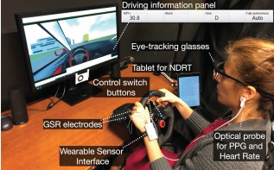
The user study set-up
Source: Pakdamanian et al., 2021. CHI’2021 https://dl.acm.org/doi/pdf/10.1145/3411764.3445563

Slide 13
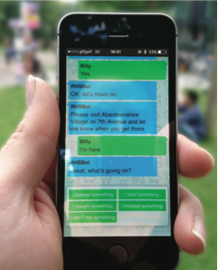
Ethnobot: Gathering Ethnographic data at the Royal Highland Show
The Ethnobat directed Billy to a particular place (Aberdeenshire Village)
Next, Ethnobot asks “…what’s going on?”
The screen shows five of the experience buttons from which Billy needs to select a response
Source: Tallyn et al. (2018) Reproduced with permission of ACM Publications.

Slide 14
Experience responses to questions submitted in Ethnobot
Number of prewritten experience responses submitted by participants to the pre-established questions that Ethnobot asked them about their experiences
Source: Tallyn et al. (2018) Reproduced with permission of ACM Publications.

Slide 15
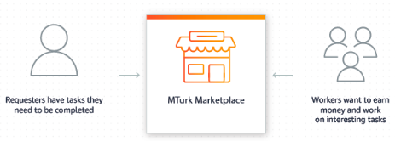
Mechanical Turk Test - Amazon

Slide 16
What did we learn from the case studies?
How to observe users in a lab simulation and in natural settings
How evaluators use different levels of control in the lab and in natural settings and in crowdsourcing evaluation studies
Use of different evaluation methods
How to develop different data collection and analysis techniques to evaluate user experience goals such as engagement
The ability to run experiments on the Internet that are quick and inexpensive using crowdsourcing
How a large number of participants can be involved in crowdsourcing using systems such as Mechanical Turk

Slide 17
Evaluation Methods
Method | Controlled settings | Natural settings | Without users
Observing | x | x
Asking users | x | x
Asking experts |  | x | x
Testing | x
Modeling |  |  | x

Slide 18
The Language of Evaluation
Analytics
Analytical evaluation
Biases
Controlled experiment
Crowdsourcing
Distributed evaluation
Ecological validity
Expert review
Field study
Formative evaluation
Heuristic evaluation
Informed consent
In the wild evaluation
Living lab
Pain points
Predictive evaluation
Reliability
Research in the wild studies
Scope
Summative evaluation
Usability lab
User studies
Usability testing
Users or participants
Validity

Slide 19
OTHER ISSUES
TO CONSIDER

Slide 20
Participants’ Rights and Getting Consent
Participants need to be told why the evaluation is being done, what they will be asked to do and informed about their rights
Informed consent forms provide this information and act as a contract between participants and researchers
The design of the informed consent form, the evaluation process, data analysis, and data storage methods are typically approved by a higher authority.

Slide 21
Things to Consider when Interpreting Data
Reliability: Does the method produce the same results on separate occasions?
Validity: Does the method measure what it is intended to measure?
Ecological validity: Does the environment of the evaluation distort the results?
Biases: Are there biases that distort the results?
Scope: How generalizable are the results?

Slide 22
Summary
Evaluation and design are very closely integrated
Some of the same data gathering methods are used in evaluation as for establishing requirements and identifying users’ needs, for example, observation, interviews, and questionnaires
Evaluations can be done in controlled settings such as lab, less controlled field settings, and remotely or without users being involved
Usability testing and experiments enable the evaluator to have a high level of control over what gets tested, whereas evaluators typically impose little or no control on participants in field studies, particularly in in the wild studies
Different methods can be combined to get different perspectives
Participants need to be made aware of their rights
It is important not to over-generalize findings from an evaluation

